Slide 1
Computer Graphics and Animations
Welcome to our presentation
Batch-B7

Slide 2
Team Members
C++
581_Afifa Shaikh
585_Ankita Yadav
582_Akshata Sharma
584_Aditya Shaw
583_Aryan Sharma

Slide 3
What is Computer Graphics Programming ?
Computer Graphics programs or visual programming is a programming technique that uses visual objects like symbols, blocks, pictures, etc., to code the program. Unlike text-based programming, it instructs the system with the help of the arrangement of the objects.

Slide 4

What is Computer Animation ?
Computer Animation is the process used for digitally generating animated images. Computer animation is essentially a digital successor to stop motion techniques, but using 3D models, and traditional animation techniques using frame-by-frame animation of 2D illustrations.

Slide 5

Program 1:
Write a program in C++ to display the following output.

Slide 6
Code
#include<iostream>
#include<graphics.h>
#include<conio.h>
int main()
{
int gd,gm;
int pentagon[12]={223,300, 180,201, 310,110, 435,200, 393,300, 223,300};
detectgraph(&gd,&gm);
initgraph(&gd,&gm,"C:\\TC\\BGI");
int a=getmaxx();

Slide 7
Code
int b=getmaxy();
setbkcolor(WHITE);
cleardevice();
setcolor(RED);
rectangle(200,406,420,420); //Base
rectangle(297,300,317,406); // Trunk setfillstyle(SOLID_FILL,RED);
floodfill(298,301,RED);
floodfill(201,407,RED); // Branch
setcolor(GREEN);
setfillstyle(SOLID_FILL,GREEN);
fillpoly(6,pentagon);
getch(); }

Slide 8

Output :

Slide 9
Program 2:
Write a program in C++ to rotate a Triangle.

Slide 10
Code
#include<stdio.h>
#include<graphics.h>
#include<math.h>
#include<conio.h>
void main() {
int gd=0,gm,x1,y1,x2,y2,x3,y3;
double s,c,angle;
initgraph(&gd,&gm,"C:\\TC\\BGI");
setcolor(YELLOW);
printf("Enter co ordinates of triangle:");

Slide 11
Code
scanf("%d%d%d%d%d%d",&x1,&y1,&x2,&y2,&x3,&y3);
cleardevice();
line(x1,y1,x2,y2);
line(x2,y2,x3,y3);
line(x3,y3,x1,y1);
getch();
printf("Enter rotation angle:");
scanf("%lf",&angle);
setcolor(WHITE);
c=cos(angle*M_PI/180);

Slide 12
Code
s=sin(angle*M_PI/180);
x1=floor(x1*c+y1*s);
y1=floor(-x1*s+y1*c);
x2=floor(x2*c+y2*s);
y2=floor(-x2*s+y2*c);
x3=floor(x3*c+y3*s);
y3=floor(-x3*s+y3*c);
cleardevice();
line(x1,y1,x2,y2);
line(x2,y2,x3,y3);
line(x3,y3,x1,y1);
getch();
closegraph();
}

Slide 13

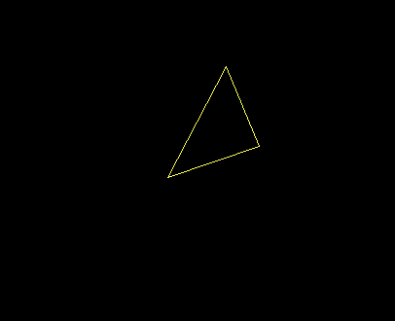
Output
Before Rotation
After Rotation

Slide 14
Program 3:
Write a program in C++ to translate a point.

Slide 15
Code
#include<iostream.h>
#include<graphics.h>
#include<dos.h>
#include<conio.h>
void main()
{
int gd=DETECT,gm;
initgraph(&gd,&gm,"C:\\TC\\BGI");
int x,y,tx,ty,x1,y1;
cout<<"Enter original co-ordinates(x,y):\n";

Slide 16
Code
cin>>x>>y;
putpixel(x,y,YELLOW);
cout<<"Enter translation vectors(tx,ty):";
cin>>tx>>ty;
x1=x+tx;
y1=y+ty;
putpixel(x1,y1,RED);
getch();
}

Slide 17
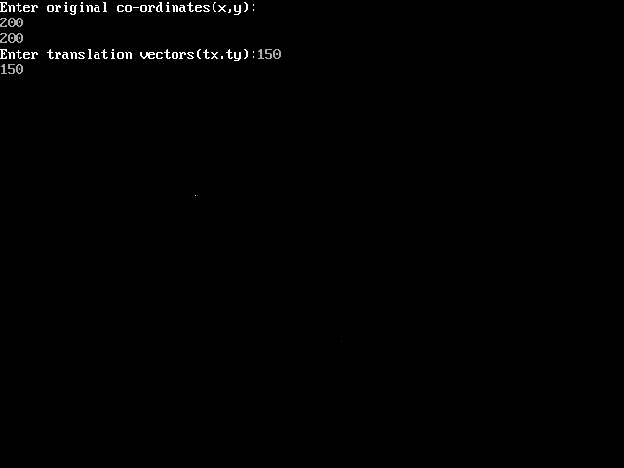
Output

Slide 18
Program 4:
Write a program in C++ for DDA circle drawing Algorithm.

Slide 19
Code
#include <graphics.h>
#include <iostream.h>
#include <math.h>
#include <dos.h>
#include <conio.h>
void main()
{
float x1,y1,x2,y2,startx,starty,epsilon;
int i,gd=DETECT,gm,val,r;
initgraph(&gd,&gm,"C:\\TC\\BGI");
cout<<"Enter the radius of a circle :";
cin>>r;
x1=0;
y1=r;
startx = x1;
starty = y1;
i=0;
do
{
val = pow(2,i);
i++;
}while(val<r);
epsilon = 1/pow(2,i-1);

Slide 20
Code
do
{
x2= x1 + y1*epsilon;
y2 = y1 - epsilon*x2;
putpixel(200+x2,200+y2,15);
x1=x2;
y1=y2;
delay(50);
}
while( (y1 - starty ) < epsilon || (startx - x1) > epsilon);
getch();
}

Slide 21
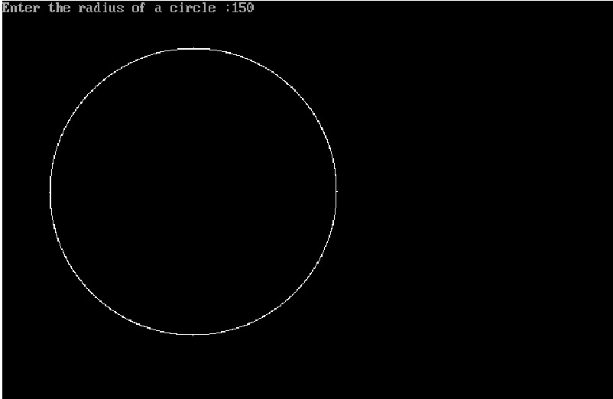
Output

Slide 22
Program 5:
Write a program in C++ to demonstrate the use of cleardevice( ) and closegraph ( ) function.

Slide 23
Code for Cleardevice( ) :
#include<iostream.h>
#include<conio.h>
#include<graphics.h>
int main()
{
int gd=DETECT,gm;
initgraph(&gd,&gm,"C:\\TC\\BGI"); setbkcolor(BLUE);
outtextxy(20,40,"Program to use graph default in C graphics");
outtextxy(20,80,"Press any Key to clear screen");
getch();
cleardevice();
outtextxy(20,20+20,"Press any key to exit...");
getch();
return 0;
}

Slide 24
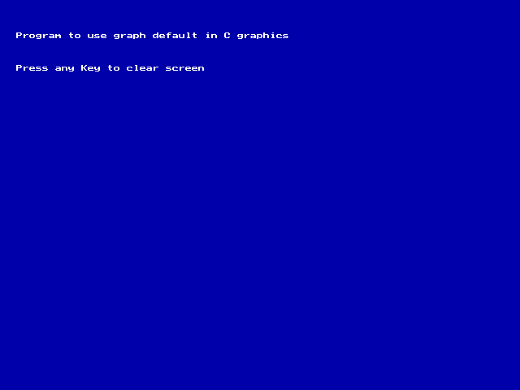
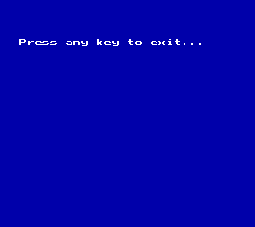
01
ABOUT US
You can enter a subtitle here in case you need it
Output

Slide 25
#include<graphics.h>
#include<conio.h> int main()
{ int gd=DETECT,gm; initgraph(&gd,&gm,"C:\\TC\\BGI"); outtext("Press any key to close the graphics mode!!"); getch(); closegraph(); return 0; }
Code for Closegraph( )

Slide 26
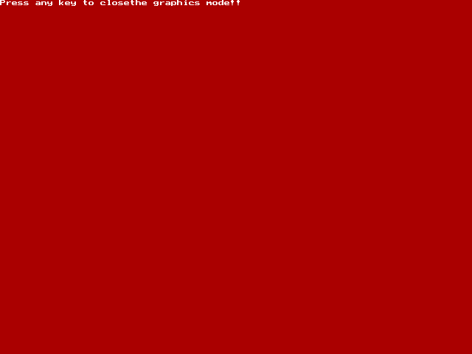
Output

Slide 27
Thankyou for listening!!
Hope you all liked our presentation !

